Slide 1
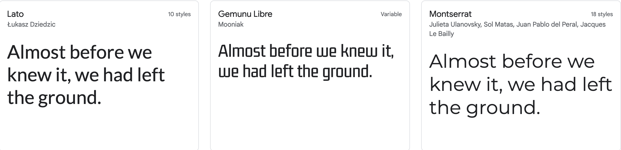
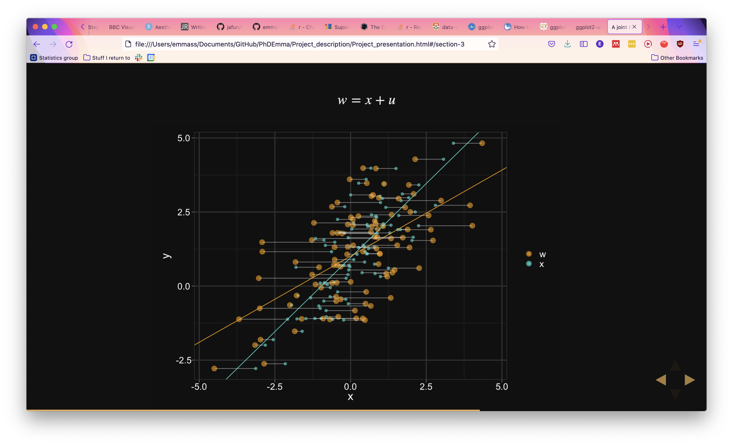
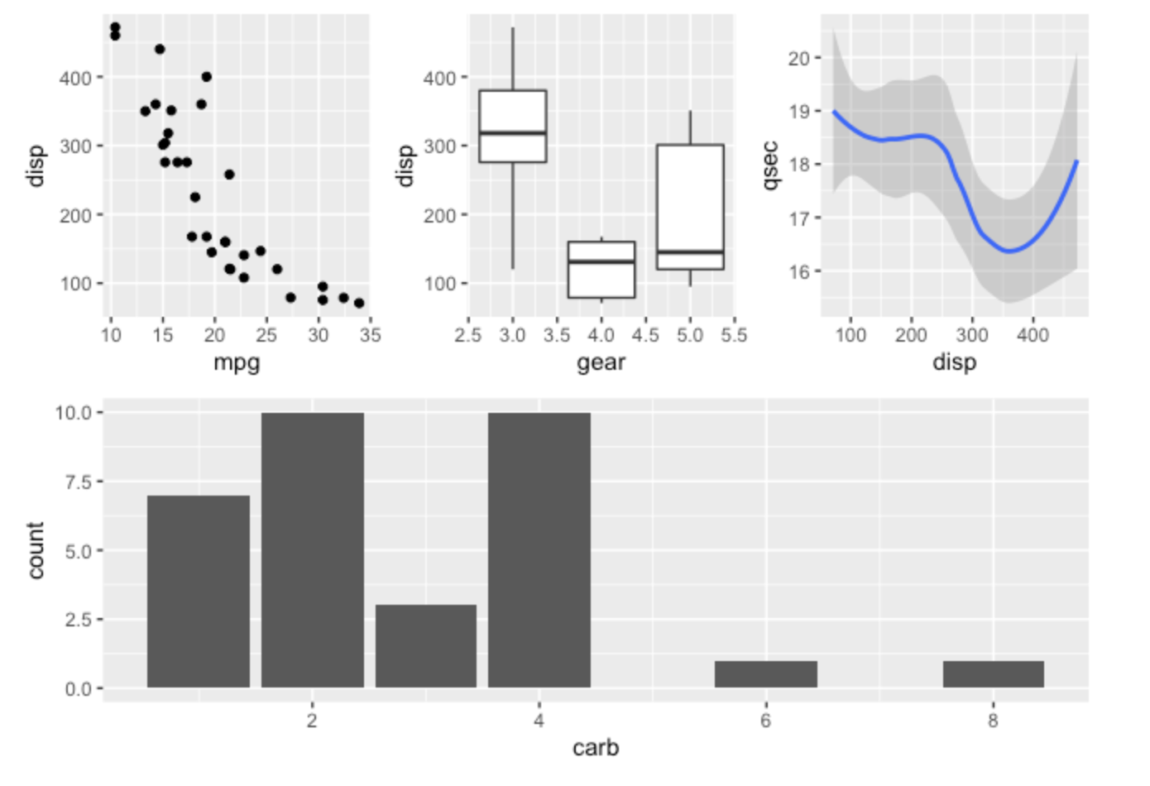
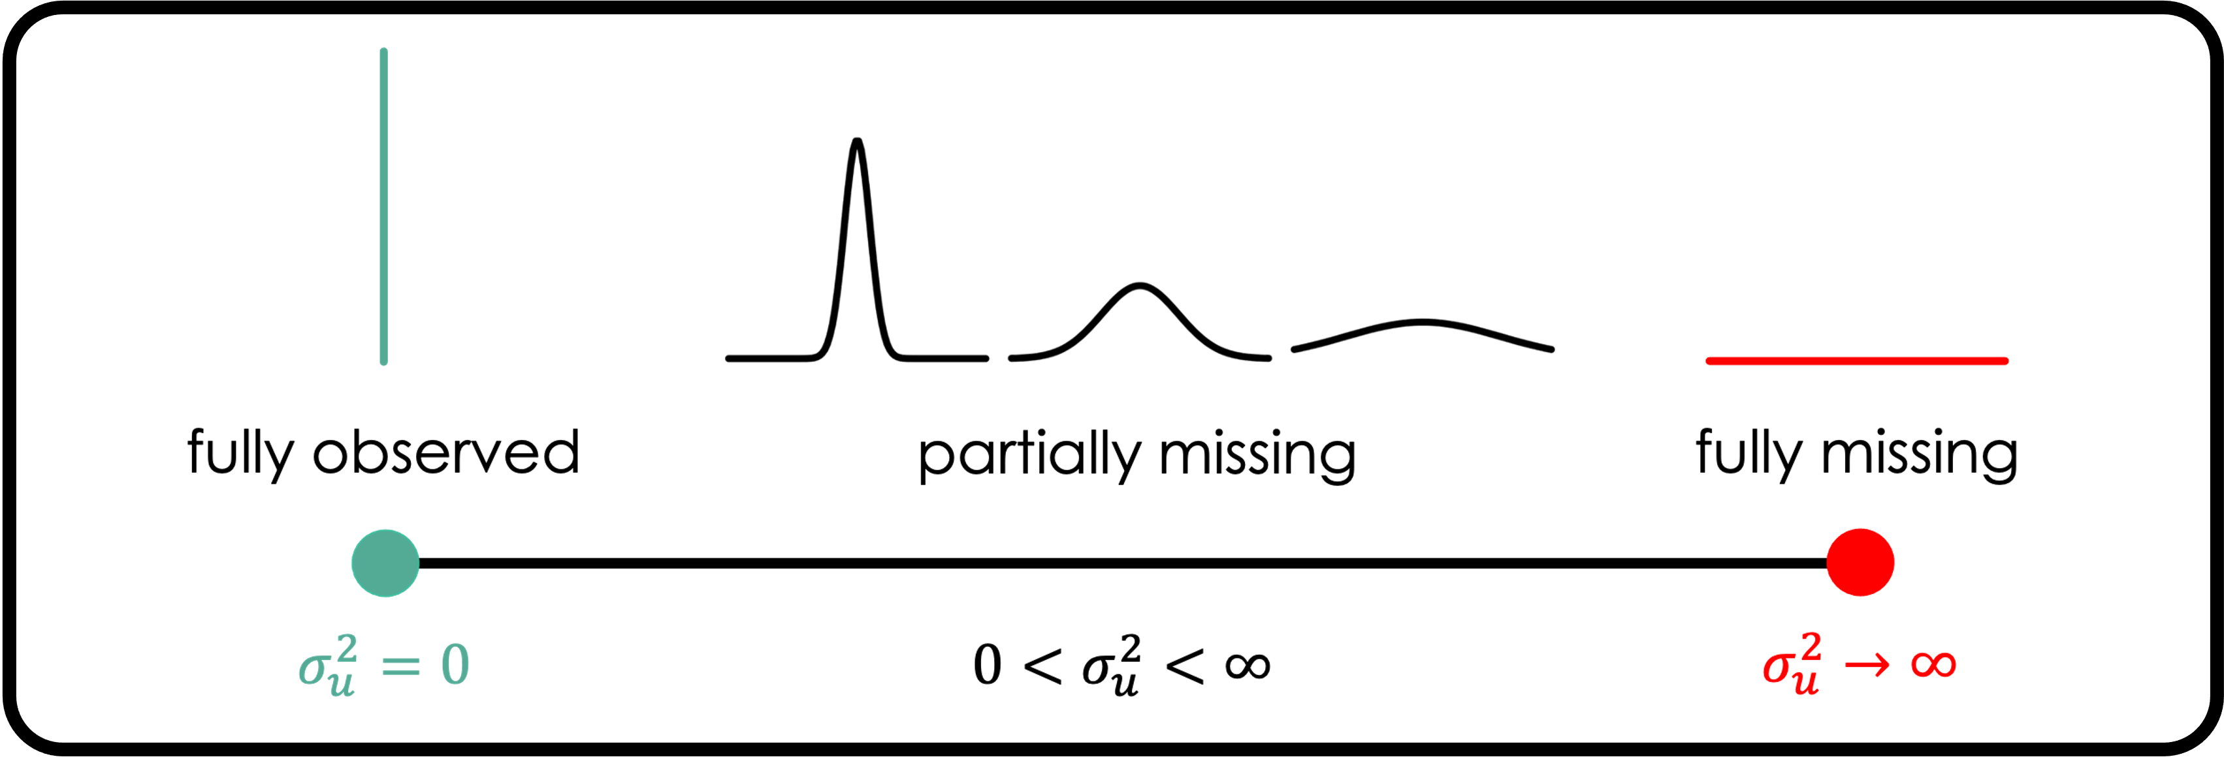

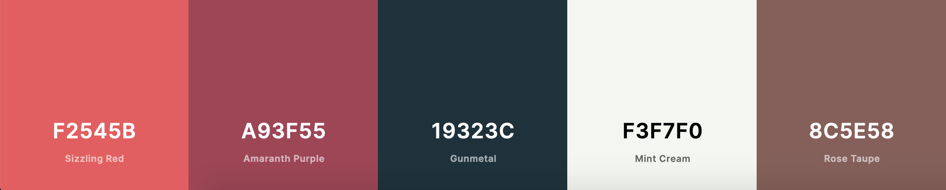
Moving beyond theme_gray Exploring customized themes for improved visualizations in ggplot2
CHEAT SHEET
Why modify the theme?
Having a consistent graphical expression throughout a paper or thesis (possibility of matching fonts and colors).
Modifying the background color of a plot to match (or contrast with) the background color of a presentation or poster.
Removing distracting and unimportant elements of a plot for presentations or posters, creating more minimal visualizations.
Helpful packages/websites
FONTS: showtext lets you easily set the font to any of the ones you find in the Google font library.
COMBINING PLOTS: patchwork for combining plots. Themes can be set on the combined plot object, making consistent theming really easy.
TRANSPARENT BACKGROUND: ggpubr has (among other things) a transparent background theme.
COLORS: This article by Lisa Charlotte Muth gives a thorough introduction to general principles in choosing colors. There are many good color palette generators out there, https://coolors.co/ is one example, if you just want a ready made palette, check this list of ggplot2 color palettes.
EXAMPLE THEMES: BBC has a really well-documented theme in their bbplot package. My personal theme is public on Github here.
# Example of a custom theme
my_basic_theme <- function(base_size = 12,
base_family = 'sans'){
return_theme <- theme(
text = element_text(family = base_family,
size = base_size),
axis.text = element_text(size = 10,
color = "black"),
plot.title = element_text(size = 20,
margin = margin(b = 5)),
plot.subtitle = element_text(size = 15,
margin = margin(b = 10)),
axis.title = element_blank(),
legend.position = "top",
legend.title = element_blank(),
legend.justification = 0,
legend.text = element_text(size = 15,
family = base_family),
panel.grid = element_blank(),
panel.background = element_rect(fill = "#F9F8F8"),
panel.border = element_rect(color = "gray",
fill = NA))
return(return_theme)
}
Defaults
Specifying font and size for various text elements
Removing axis lables
Various legend specifications
Remove background grid, set a nice gray color, and set a slightly darker gray border
# This is how the theme is used in a plotting script:
ggplot(art_artist, aes(x = year, fill = gender)) +
geom_bar() +
scale_fill_manual(values = c("#EC7238", "#66B4C0", "#1E4A76")) +
scale_x_continuous(breaks = seq(1700, 2012, by = 50),
expand = c(0.05, 0.05)) +
scale_y_continuous(limits = c(0, 3300),
expand = c(0.001, 0)) +
labs(title = "TATE ART MUSEUM\nPieces created each year",
subtitle = "1700 - 2012",
caption = "Source: Tate Art Museum / TidyTuesday |
Visualization: Emma Skarstein") +
my_basic_theme(base_family = "Nunito")
The basic bar-plot
Custom colors
Scale axes, let y-axis start at 0
Title, subtitle, and caption
Finally, adding my theme!
Organizing your themes
IN THE PLOT-CODE: If your theme is specific to a single plot you are making, there is little to gain from specifying the theme outside of the plotting call itself.
IN A THEME-FUNCTION: However, if you are going to apply the theme to two or more plots, you should specify it in it’s own function.
IN A PACKAGE: If there are specific theme changes you find yourself doing consistently (like font, background colors, line preferences, etc.) you can make a graphics-package with your favorite custom themes.
Created for NTNU statistics coding group, October 2021 • Emma Skarstein • emma.s.skarstein@ntnu.no • Updated: 2021-10

Slide 2
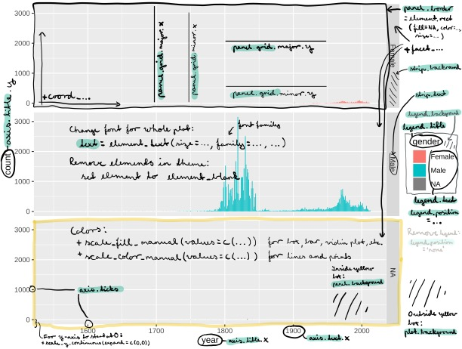
THE ANATOMY OF A ggplot2-PLOT
Emma Skarstein • emma.s.skarstein@ntnu.no • Updated: 2021-10

